Slide 1
High SCHOOL 101:
High School AND Beyond
From Henry M. Jackson High School Counselors

Slide 2
Welcome TIMBERWOLVES!
Today we are going to:
Define “credit”
Review graduation requirements
Access your email
Access your transcript/grades
Meet your counseling/support staff at Jackson

Slide 3

How many credits do I need to graduate?
You have to earn 24 credits to earn your high school diploma.
  9th grade- 6.0 credits (pass ALL classes)
  10th grade- 6.0 credits (pass ALL classes)
  11th grade- 6.0 credits (pass ALL classes)
  12th grade- 6.0 credits (pass ALL classes)
  TOTAL= 24 Credits
Notes:
Ask students how many credits how many credits they need to earn each year to stay on track to graduate?

Slide 4
Example of 9th grade schedule
1st Semester
2nd Semester
CREDITS
1.0
1.0
1.0
1.0
1.0
1.0
Total: 6 Credits
Pre-AP English 9 (.5 Credits)
Algebraic Concepts (.5 Credits)
Biology(.5 Credits)
Health (.5 Credits)
Spanish 1 (.5 Credits)
Digital Photography (.5 Credits)
Pre-AP English 9 (.5 Credits)
Algebraic Concepts (.5 Credits)
Biology (.5 Credits)
PE 1 (.5 Credits)
Spanish 1 (.5 Credits)
Intro to Graphic Design (.5 Credits)
This semester, if you pass all of your classes, you will earn 3.0 credits. Next semester, if you pass all your classes, you will earn another 3.0 credits. This will give you 6.0 credits by the end of the year!
Notes:
Discuss an example of a typical schedule and how each class the pass earns them .5 credits.

Slide 5
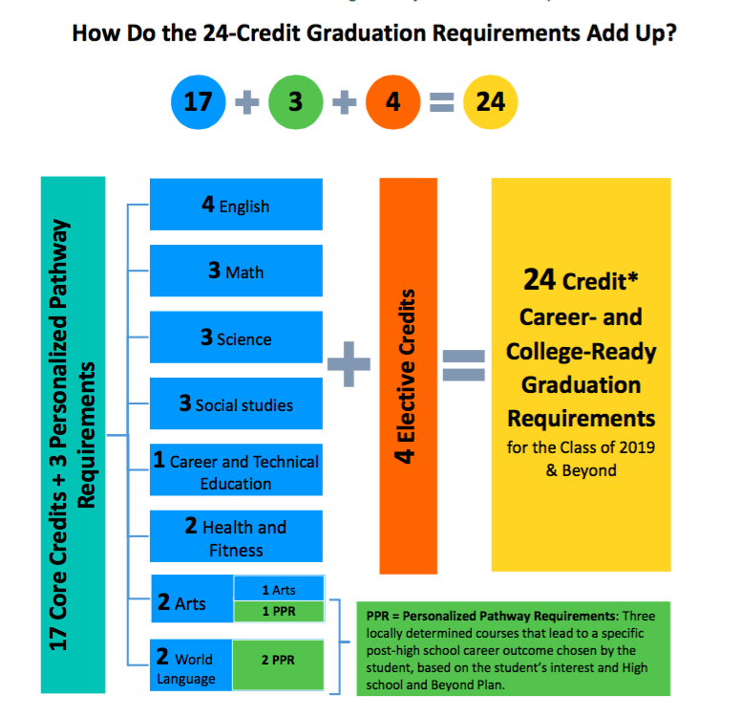
Graduation requirements
English 4.0 Credits
Social Studies 3.0 Credits
Math 3.0 Credits
Science 3.0 Credits
P.E. 1.5 Credits
Health 0.5 Credit
Career & Tech Ed 1.0 Credit
Fine Arts 2.0 Credits**
World Language 2.0 Credits**
Electives 4.0 Credits
Total 24.0 Credits
**Personalized Pathway Requirement
Notes:
Show this screen to highlight the different type of credits students need to graduate.

Slide 6

Personalized pathway requirements (PPR)
3 flexible credits based on your interests and career/education goals and your High School & Beyond Plan
Can substituted for the following credits:
2 credits of Foreign Language
-And/Or-
1 credit of Fine Art
You can discuss options with your school counselor
Notes:
Can say: A Personalized Pathway is a locally determined body of coursework that is deemed necessary to attain the post-secondary career or educational goals chosen by the student. Within the 24-credit graduation requirement framework, the Personalized Pathway Requirements are three flexible credits that a chosen by student that help prepare the student for specific education or career goals.”
*Tell students they will identify a PPR, if needed, as part of their HS and Beyond Plan which will be completed in a future lesson.

Slide 7

Additional Graduation requirements
Graduation Pathways:
  State Assessments (Primary way to meet WA State Grad. Pathway)
  Smarter Balanced ELA (in 10th grade)
  Smarter Balanced Math (in 10th grade)
  Washington Comprehensive Assessment of
  Science (in 11th grade)
  *There are additional pathway options that can be discussed with your school counselor if needed.
Additional Requirements
  High School and Beyond Plan (completed in Naviance)
  Senior Quantitative Class Requirement (Math or Science)
  College and Career Readiness Seminar (completed Senior Year)
Notes:
Tell students their counselors will be discussing their graduation pathways with them, as well as all graduation requirements before they graduate.

Slide 8
What is the high school and Beyond Plan?
A High School and Beyond Plan (HSBP) is an important step in transition to life after high school
The HSBP will help you set short and long term goals, prepare for, and be ready, for your post-high school training and future career plans.
You will be revising your High School and Beyond Plan as your interests and/or goals change over the next four years.
You will complete three primary tasks this year as part of your High School and Beyond Plan in Naviance.
The HSBP is a graduation requirement for all JHS students.
Notes:
HSBP contains:
an identification of career goals, aided by a skills and interest assessment;
an identification of educational goals;
a four-year plan for course-taking that fulfills state and local graduation requirements and aligns with the student's career and educational goals;
and by the end of twelfth grade, a current resume or activity log that provides a written compilation of the student's education, any work experience, and any community service and how the school district recognized the community service.

Slide 9

Credit opportunities in High School
Advanced Placement
College in the High School
Naval Junior Reserve Officer Training Corps (NJROTC) at Everett High School
Signature STEM program (offering Automotive, Manufacturing and Health Science Options)
Regional Apprenticeship Program (RAP) focused on Contruction Trades
Running Start
Sno-Isle Tech
Notes:
Tell students there are many ways to complete their education and even earn college credit in high school. This will also be discussed during registration advisory. Feel free to discuss classes you teach/have thought in these areas. Links are provided if you'd like to show students where they can find more information.

Slide 10



Step 1:
Opening Your School Email
From the JHS Counseling Webpage, click on Students website
Step 2:
Click on Office 365
Notes:
Ask students to open up their laptops and direct them to either Jackson’s website.

Slide 11

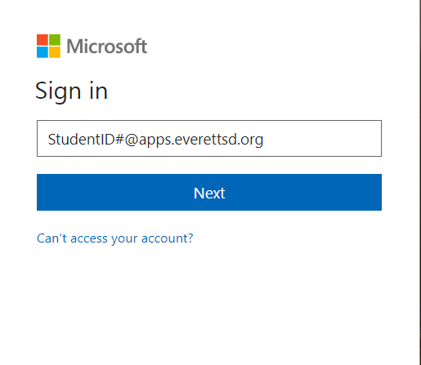

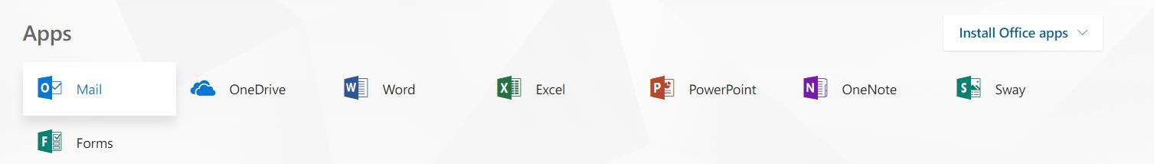
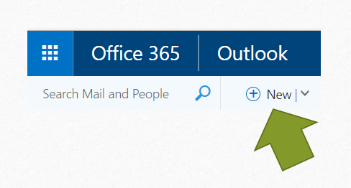
Step 3:
Opening Your School Email
Enter your studentID# @apps.everettsd.org
Example: 12345@apps.everettsd.org
Step 4:
Click on the “Mail” icon to view your current emails
and “New” to create a new email
Notes:
Direct students to send an email to a teacher or counselor with the subject line “HS and Beyond Lesson 1” and any message they would like in the body of the email. Point out that once students start writing a name in the “TO” box it should auto populate the rest of the name if typed correctly.

Slide 12
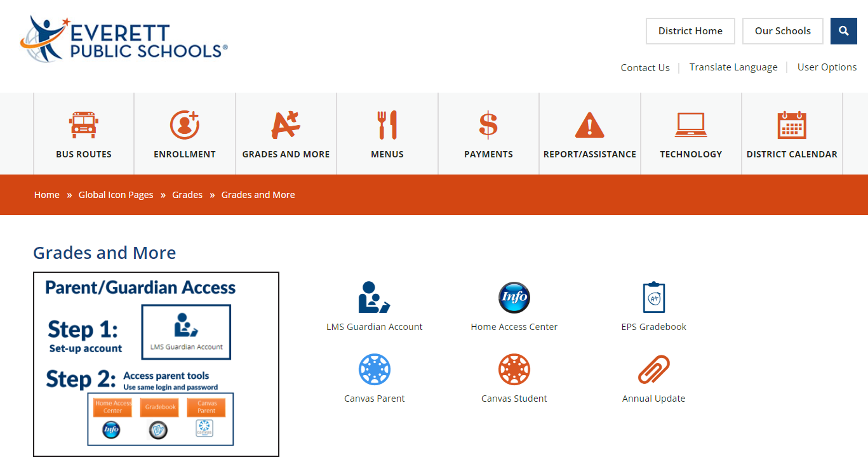
Grades and MORE
Step 1:
Step 2:
Click A+ Grades and More on any Everett School webpage
Click EPS Gradebook to check grades, missing assignments, and your schedule.
*You can also access grades and your transcript by selecting Home Access Center

Slide 13
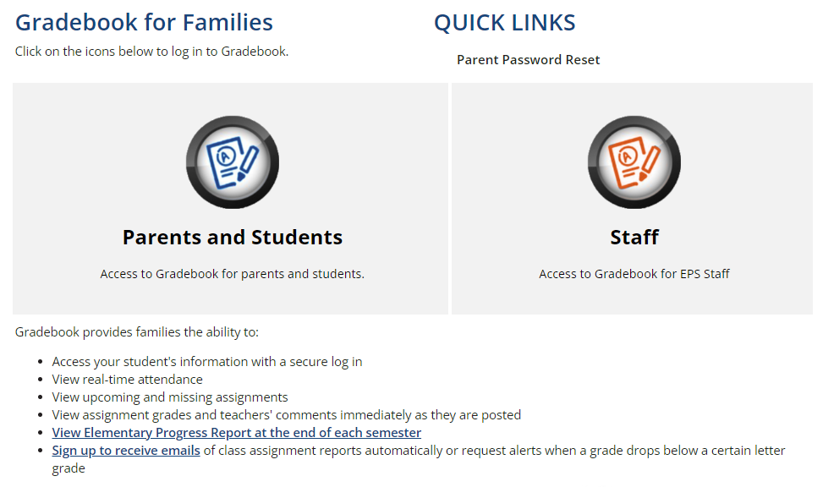
Grades and MORE
Step 3:
Click icon above “Parents and students” and then login using your student ID# and computer district password
Step 4:
Select “Grades” to see current grades and review missing assignments
Notes:
This is a great opportunity to discuss your class gradebook and how to view missing assignments.

Slide 14
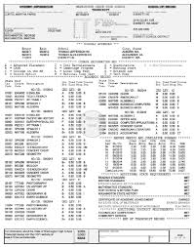

Transcript
A high school transcript is an official record of a student's academic performance during their time in high school.
It includes:
Courses taken: A list of all classes the student has completed by year.
Grades: The grades received for each course, by semester.
Credits earned: The number of credits awarded for each course, which contribute to meeting graduation requirements.
GPA (Grade Point Average): A cumulative grade point average that reflects the student’s overall academic performance.
Graduation requirements: Whether additional graduation requirements have been met.
High school transcripts are important for college admissions, scholarships, and job applications, as they provide a snapshot of the student's academic achievements.
Notes:
Tell students that a transcript is an official record of their academic history in high school and includes HS eligible classes from MS, online and summer classes and any college classes they might take.
MS grades/credit can be removed, and students can do so by connecting with our registrar and/or school counselor.

Slide 15
Transcript
Step 1:
Step 2:
Click A+ Grades and More on any Everett School webpage
Click Home Access Center to access transcript, grades, schedule and more.
Notes:
Tell students this is how to access an unofficial copy of their transcript. For an official copy, please connect with our registrar (via the main office) or check out the transcript webpage on the Jackson website.

Slide 16
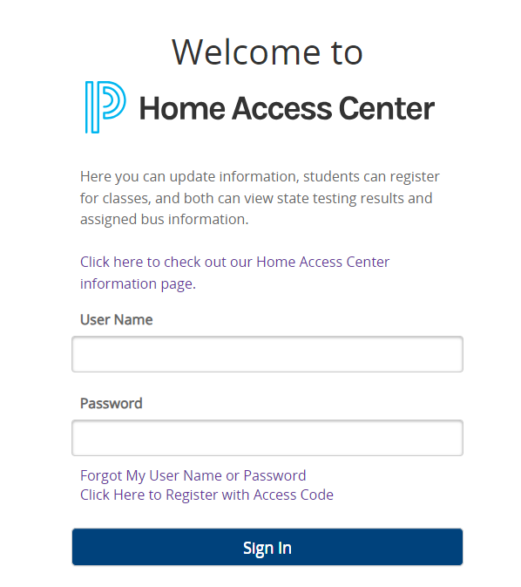
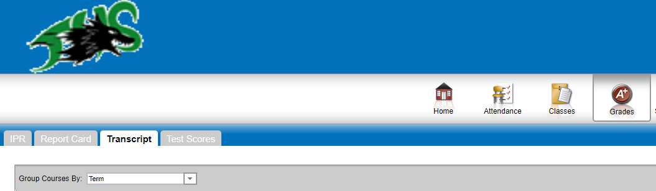
Transcript
Step 3:
Step 4:
Click blue info button and then login using your student ID# and computer district password
Click “Classes” icon and then the Transcript tab to view you latest transcript
Notes:
Students can view their transcript from home and often use screenshots for jobs, insurance and college applications that will accept an unofficial copy.

Slide 17

Tools for success!
Attend school everyday.
Use a Planner
Set home work time every day (start small, maybe 5 min. and grow)
Make a weekly appointment to check grades and Canvas with parent/guardian
Manage phone use/social media
Notes:
Please review each point with students, as time allows. Please offer your own guidance on what you find successful in your classroom.

Slide 18
More Tools for success!
6. Practice good sleep habits
7. Get involved (PTSA, Clubs, Sports)
8. Give grace and practice patience (with yourself and your family)
9. Utilize available resources (PACK time, teacher office hours, available tutoring)
Notes:
Please review each point with students as time allows. Please offer your own guidance on what you find successful in your classroom.

Slide 19

Overcoming challenges
Utilize resources available including:
  Teacher office hours
  PACK Time
  Tutoring opportunities through NHS
  Online academic supports
JHS Website and Counseling Webpage
Connect with your School Counselor!

Slide 20


Your JHS Counseling Team and Support Staff!
See More on our Counseling Webpage
Notes:
Please ask students (and do so yourselves) the main counseling webpage where students can find their counselor, support staff, and links to our various webpages including college/career website.

Slide 21
What can your school counselor Do For you?
Academics
Guidance & Counseling Services
Review Graduation requirements
Class Schedule & Registration
Options and procedures for making up classes and credits
Personal & Social Services
Peer mediation
Practice decision making skills
Crisis counseling and referral
Intrapersonal and interpersonal development
College/Career Guidance
College information:
  Admission requirements
  Transcript review
  Scholarship and financial aid
Educational and career planning
Classroom college/career units
Career awareness and exploration
Job search information
Military, apprenticeship, technical, 2-year, 4-year college information
Notes:
Let students read on their own.

Slide 22
Next HS & Beyond Lesson: November 14 HS & Beyond Plan, Task #1

